Slide 1
Virtual Memory
Operating Systems

Slide 2
Background
The term “virtual memory” refers to something which appears to be present but actually it is not.
The virtual memory technique allows users to use more memory for a program than the real memory of a computer.
Virtual memory is a concept that we use when we have processes that exceed the main memory.
When computer runs out of physical memory, it writes its requirement to the hard disc in a swap file as “virtual memory”.

Slide 3
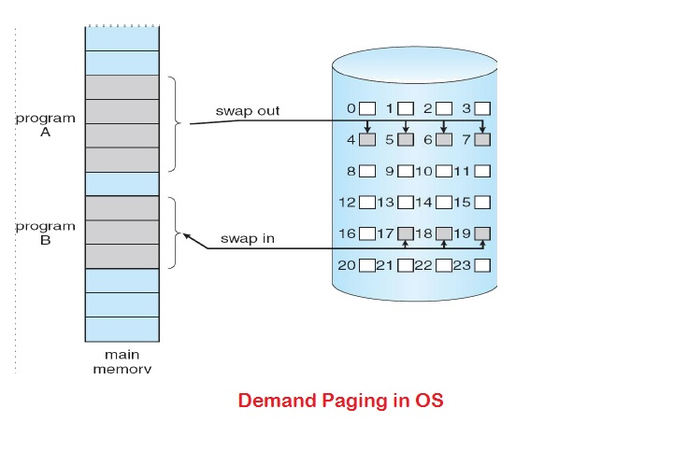
Demand Paging
Bring a page into memory only when it is needed
Less I/O needed
Less memory needed
Faster response
More users
Disadvantage: Page fault interrupt
Required hardware support:
Page Table with valid-invalid bit
Secondary memory

Slide 4
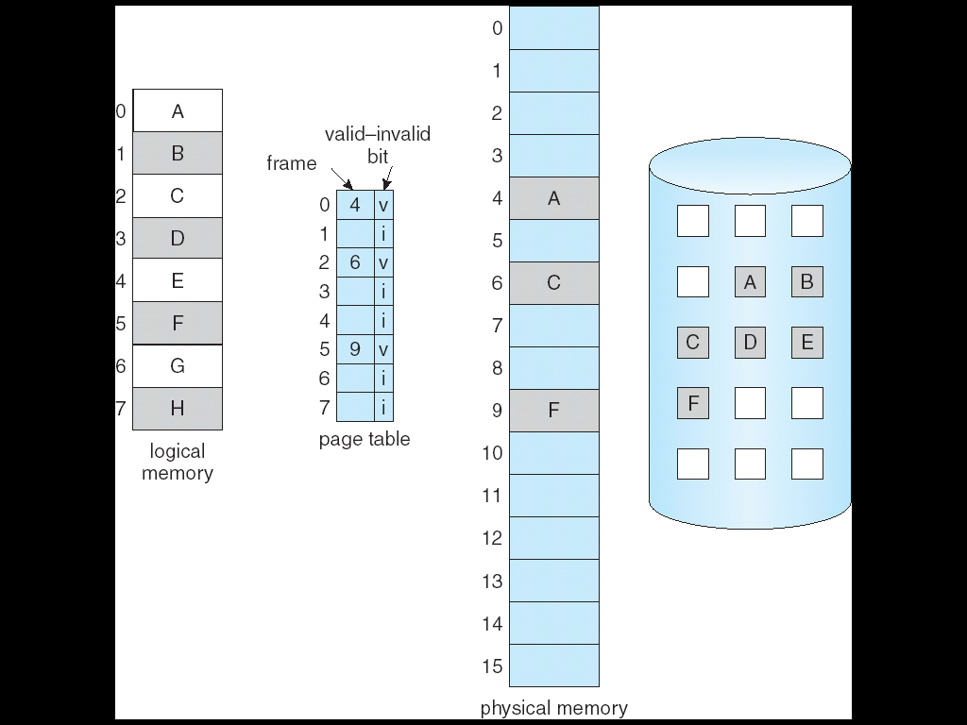
Valid-Invalid Bit
An extra bit in the page table which indicates the existence of the page in the main memory.
Attempt to access page
If page is valid (in memory) then continue processing instruction as normal.
If page is invalid then a page-fault trap / page-fault interrupt occurs.
Page is needed ⇒ reference to it
Invalid reference ⇒ abort
Not-in-memory ⇒ bring to memory

Slide 5
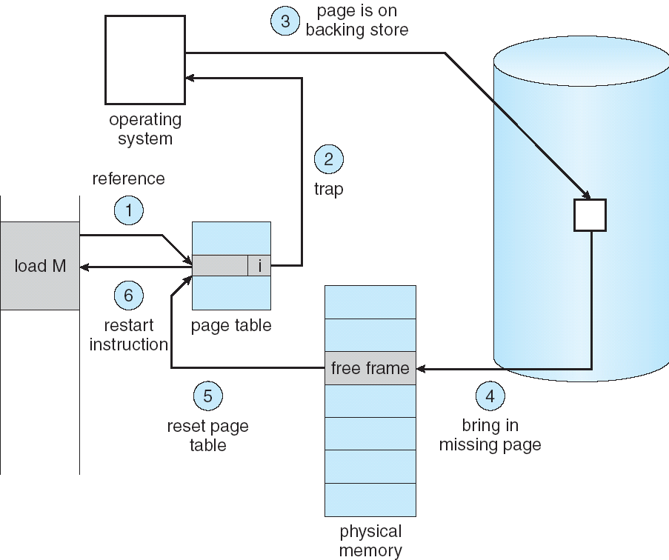
Page Fault
If there is ever a reference to a page, first reference will trap to OS ⇒ page fault
OS looks at another table to decide:
Invalid reference ⇒ abort.
Just not in memory.
Find empty/ free frame.
Load page from disk into frame.
Reset tables, validation bit = 1.
Restart instruction that caused page fault

Slide 6
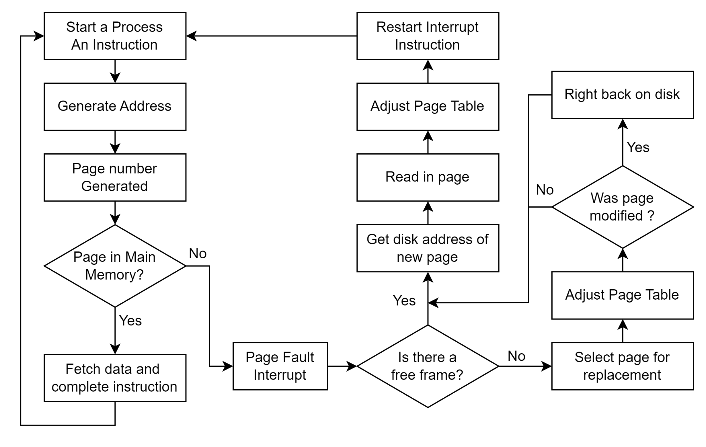
Demand Paging Flowchart

Slide 7
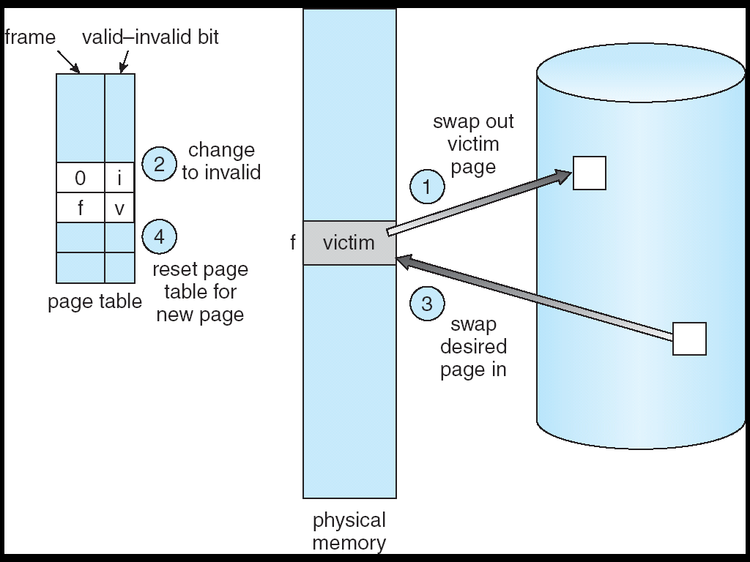
Page Replacement
Page Replacement Algorithms:
FIFO (First In First Out)
LRU (Least Recently Used)
OPT (Optimal)

Slide 8

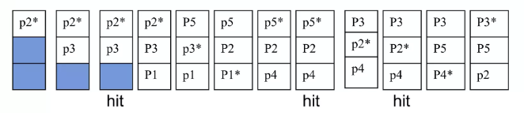
FIFO (First In First Out)
Selects the page for replacement that has been in the memory for the longest amount of time

Slide 9
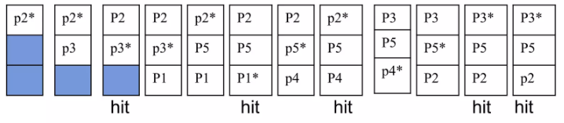
LRU (Least Recently Used)
Replace the least recently used page in the past
Can be implemented by associating a counter with every page that is in main memory

Slide 10
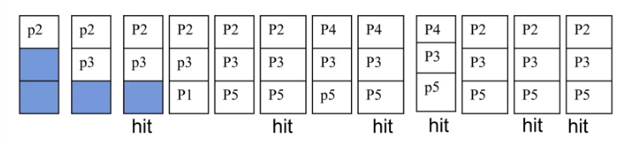
Optimal
Replace the page which is not used in longest dimension of time in future

